Slide 1
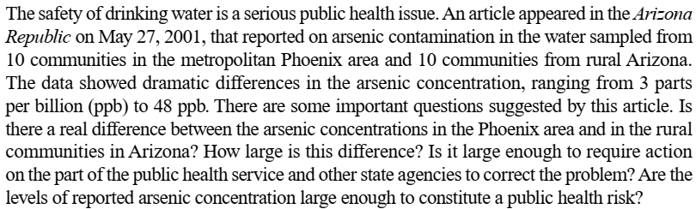
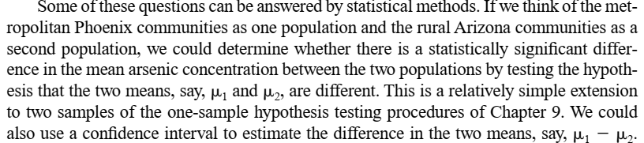

Slide 2
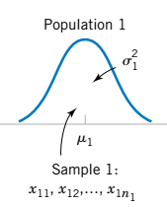
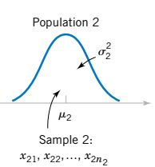
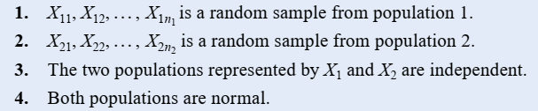
10-1.1 Hypothesis Tests on the Difference in Means, Variances Known
Assumptions for Two-Sample Inference

Slide 3



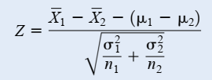
10-1.1 Hypothesis Tests on the Difference in Means, Variances Known
Random sample:
Mean:
Variance:
N(0, 1) distribution

Slide 4
Hypothesis Tests on the Difference in Means, Variances Known
Random sample:
Mean:
Variance:
N(0, 1) distribution

Slide 5
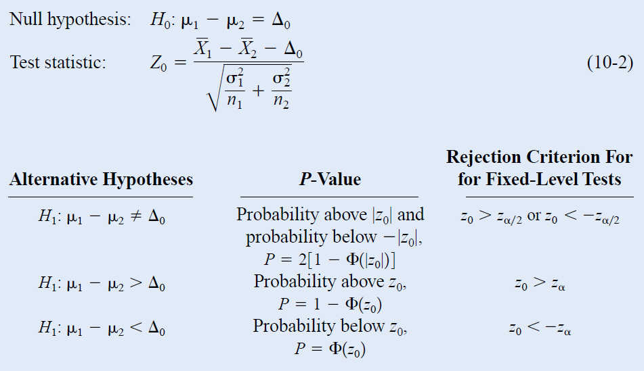
10-1.1 Hypothesis Tests on the Difference in Means, Variances Known

Slide 6
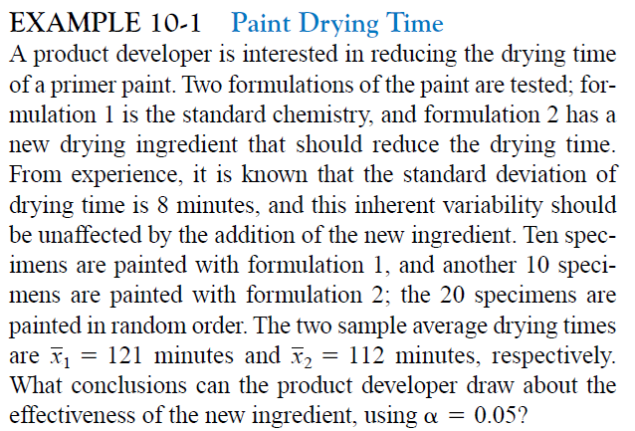
10-1.1 Hypothesis Tests on the Difference in Means, Variances Known

Slide 7


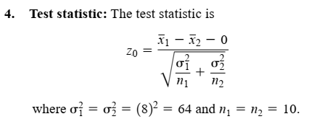
10-1.1 Hypothesis Tests on the Difference in Means, Variances Known

Slide 8

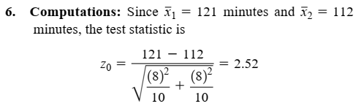

10-1.1 Hypothesis Tests on the Difference in Means, Variances Known
Practical Interpretation: We conclude that adding the new ingredient to the paint significantly reduces the drying time.
This is a strong conclusion.

Slide 9
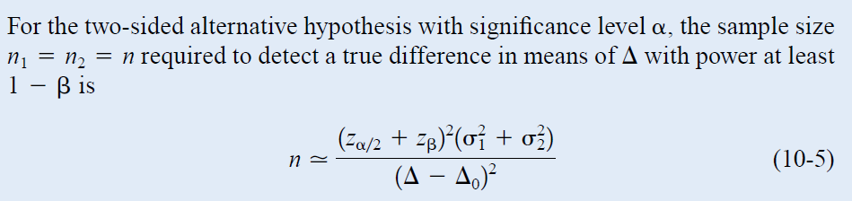

Slide 10
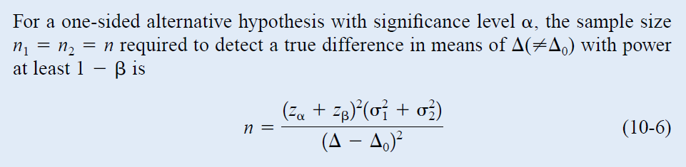
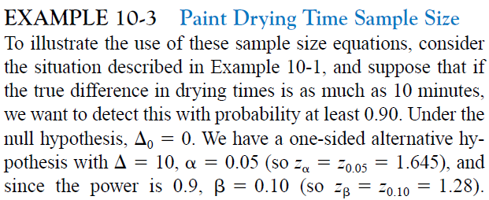

Slide 11
Confidence Interval on the Difference in Means, Variances Known

Slide 12
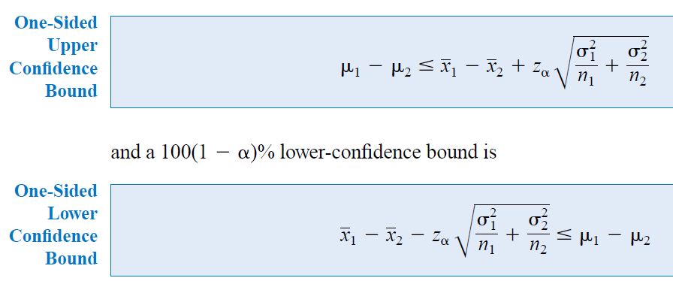

Slide 13
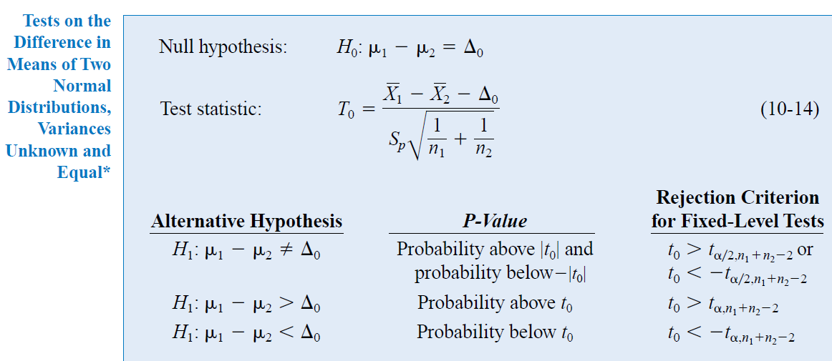
10-2.1 Hypotheses Tests on the Difference in Means, Variances Unknown
Notes:
T0~T(n1+n2-2)

Slide 14
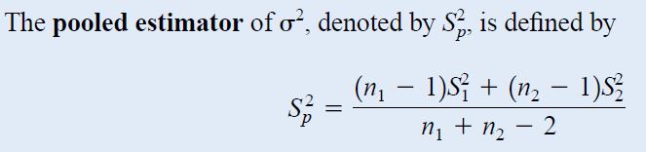
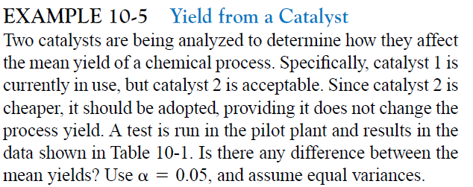

Slide 15
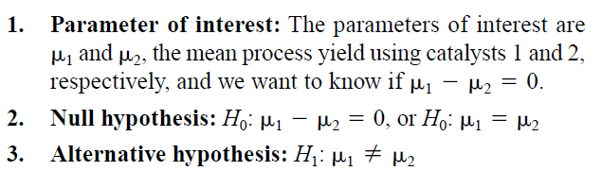
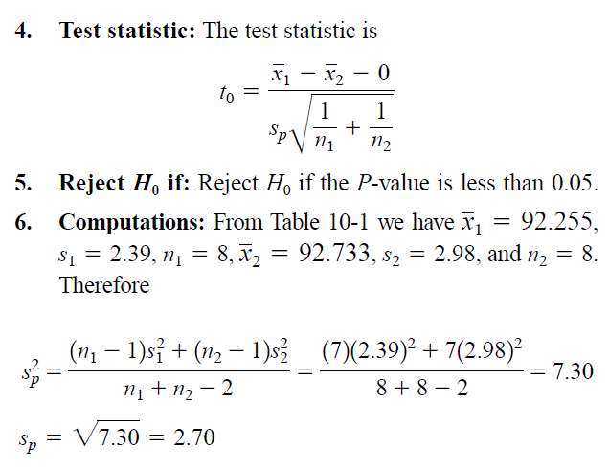

Slide 16
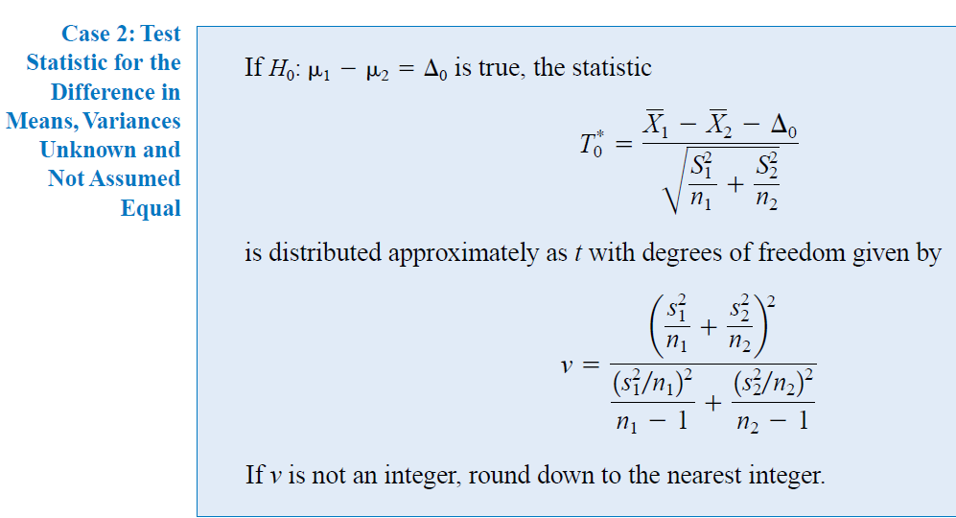

Slide 17
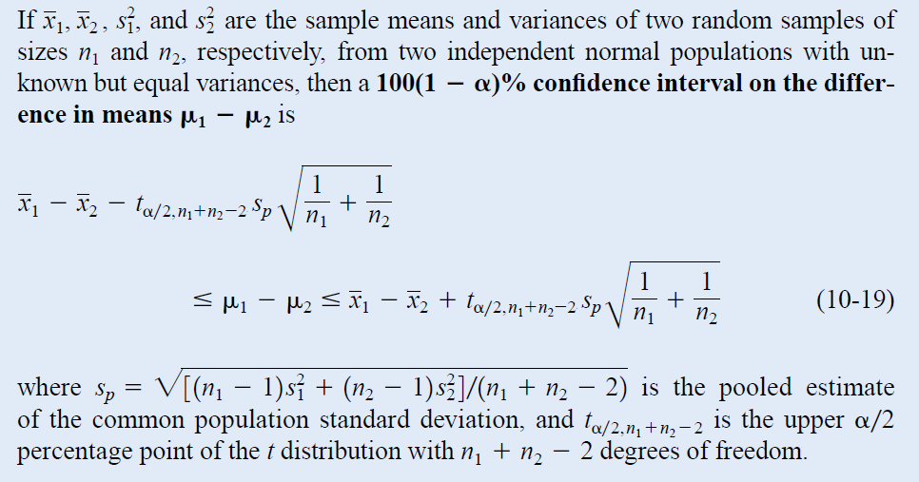

Slide 18
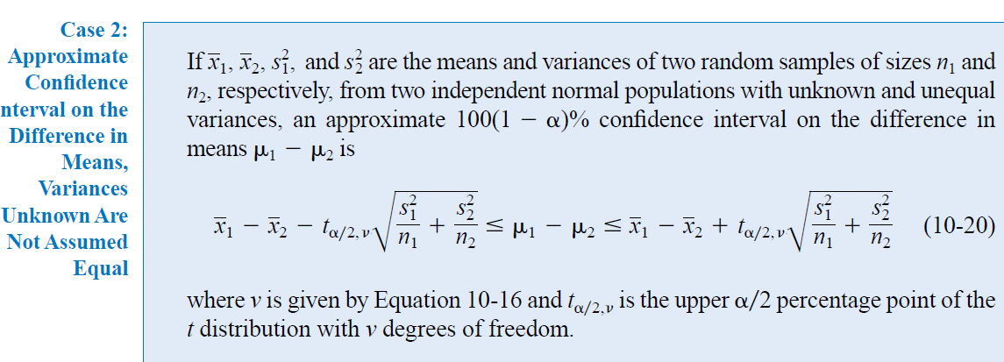

Slide 19
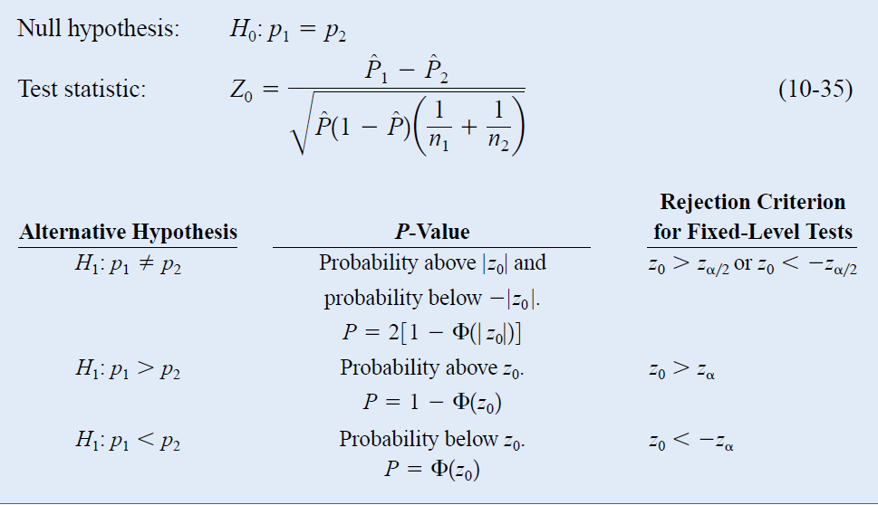
10-6.1 Large-Sample Tests on the Difference
in Population Proportions

Slide 20
EXAMPLE 10-15 St. John’s Wort
Extracts of St. John’s Wort are widely used to treat depression. An article in the April 18, 2001, issue of the Journal of the American Medical Association (“Effectiveness of St. John’s Wort on Majo Depression: A Randomized Controlled Trial”) compared the efficacy of a standard extract of St. John’s Wort with a placebo in 200 outpatients diagnosed with major depression. Patients were randomly assigned to two groups; one group received the St. John’s Wort, and the other received the placebo. After eight weeks, 19 of the placebo-treated patients showed improvement, whereas 27 of those treated with St. John’s Wort improved. Is there any reason to believe that St. John’s Wort is effective in treating major depression?

Slide 21
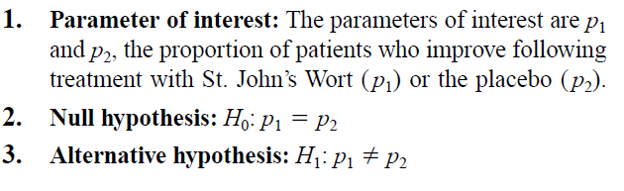
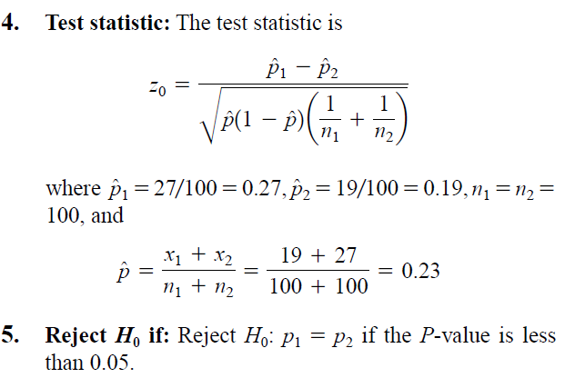

Slide 22
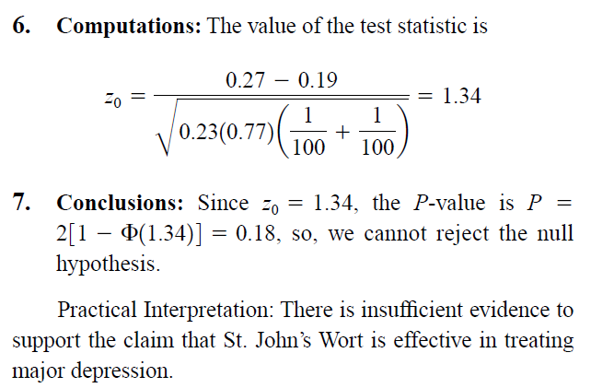

Slide 23
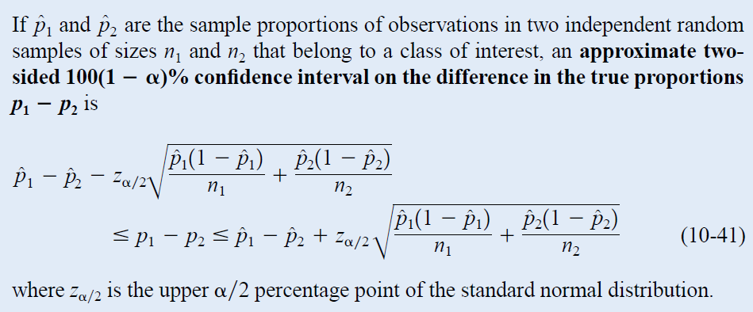
10-6.3 Confidence Interval on the Difference in Population Proportions

